Slide 1
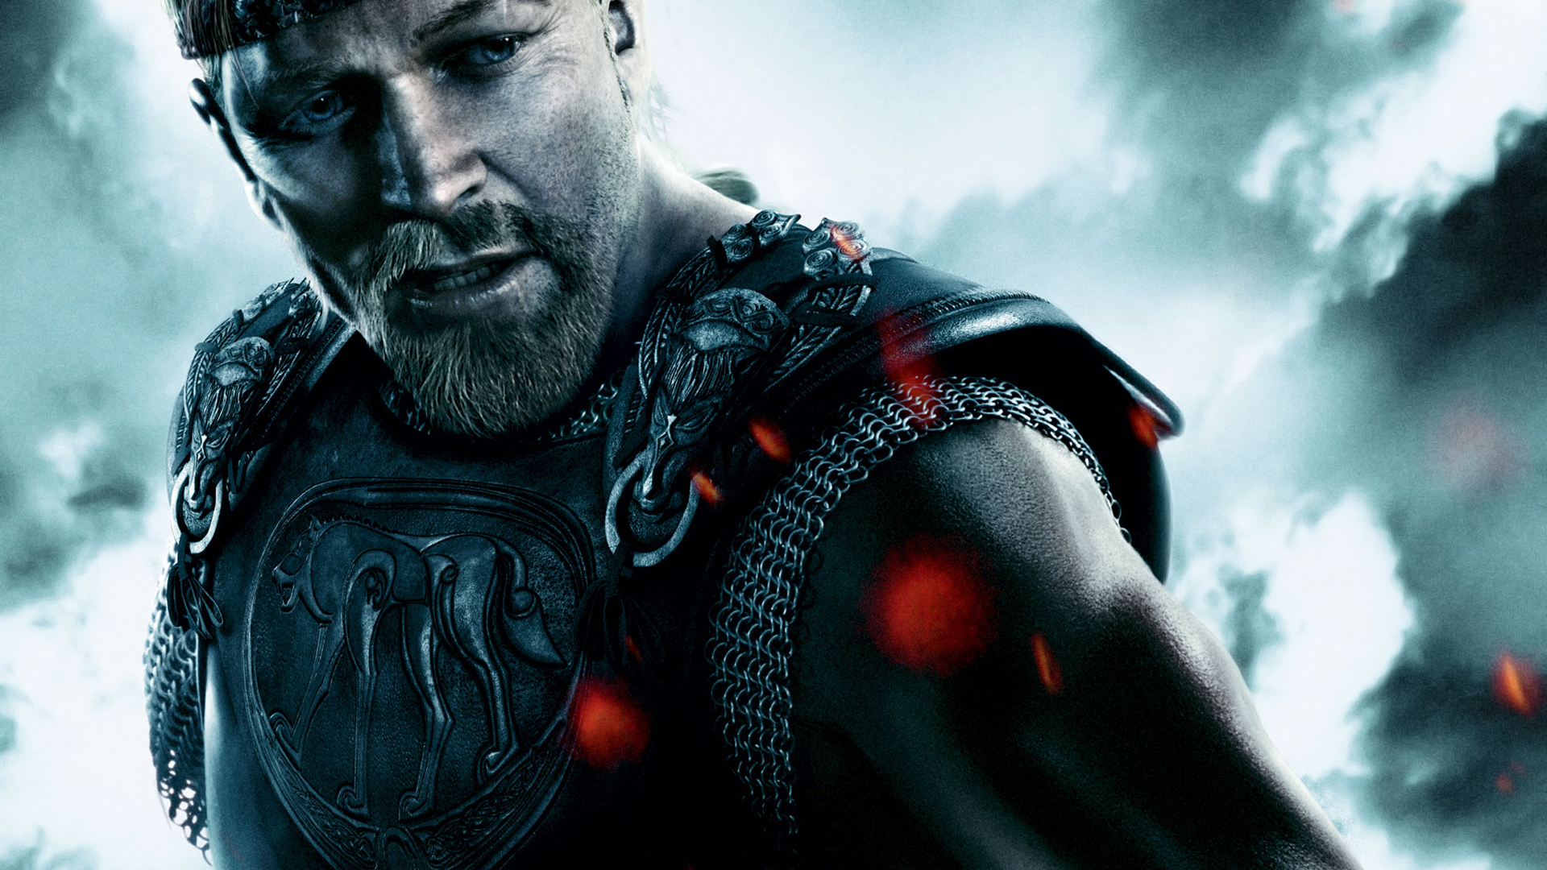
Introduction to Beowulf Epic Poem

Slide 2
Beowulf is a long, epic poem.
Epic Poem
An epic poem is a long poem that tells a story about the deeds of warriors and heroes.

Slide 3
It was first composed in 650AD . We do not know exactly when it was first told. It was not written down for another 300 years.
Harry Potter and the Philosopher’s Stone
Beowulf
0 500 1000 1500 2000
Canterbury Tales
Alice in Wonderland
How did people know the story if it was not written down?

Slide 4
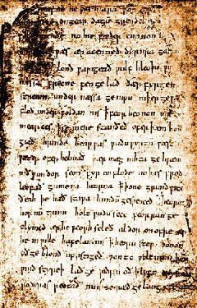
Beowulf is famous for two reasons.
It was the first story ever written down in the language of the people who lived in the dark ages.
It is the oldest British story of which we have a record.
< Here is a page of the original manuscript.

Slide 5
The beginnings…
The poem Beowulf tells of Beowulf the Great, a warrior from Sweden, who travels to Denmark to end the twelve-year reign of terror of Grendel and Grendel's mother.
Beowulf (Old English - pronounced [be-oh-wulf]) is a legendary Geatish hero and later turned king in the epic poem named after him, one of the oldest surviving pieces of literature in the English language.
http://www.youtube.com/watch?v=Y13cES7MMd8&feature=related

